Slide 1

Frances Burney’s Cecilia, Toxic Men, and the Natural Language Toolkit
Hilary Havens, University of Tennessee
https://tinyurl.com/Havens-SEASECS

Slide 2
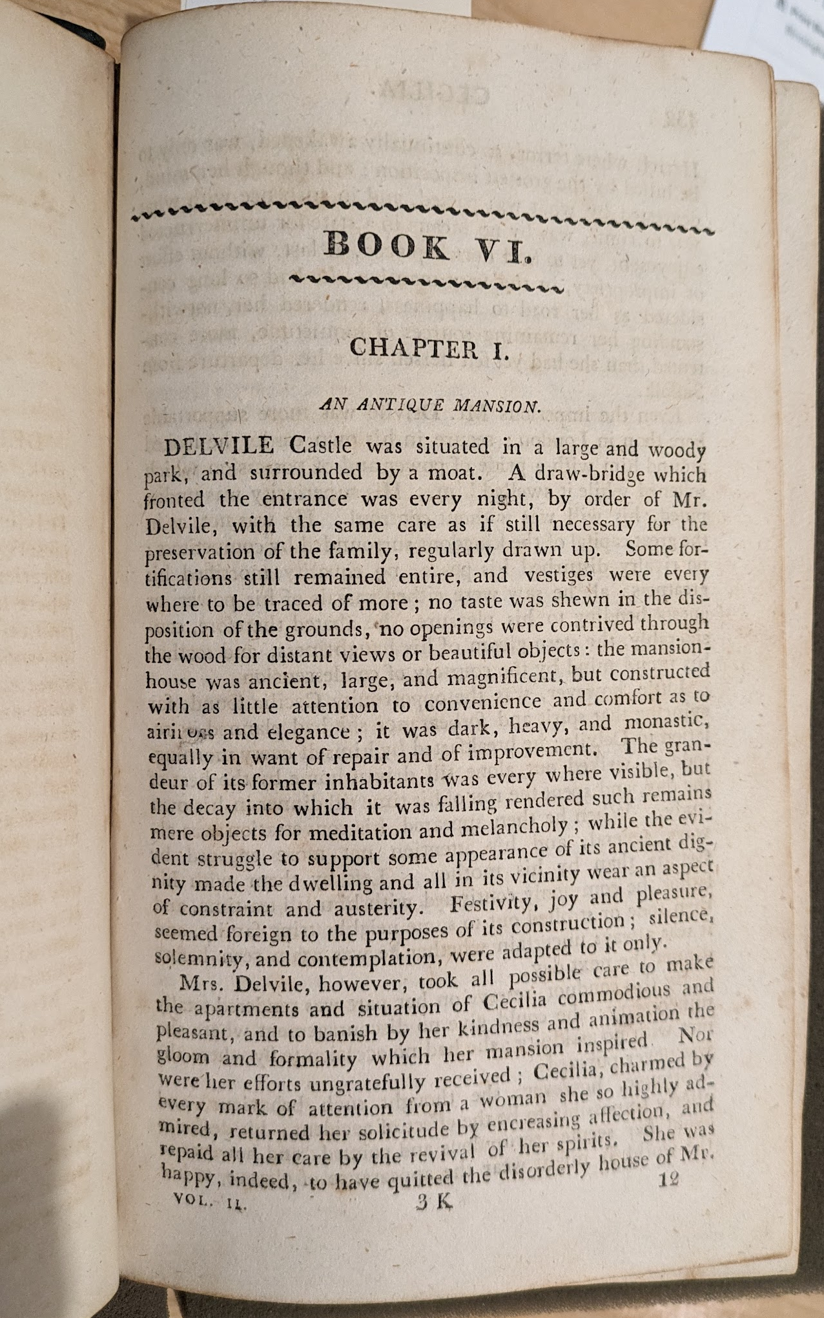
The first page of volume 2 of:
Cecilia; or, Memoirs of an Heiress. An Interesting Novel. By Miss Burney, Author of Evelina, and Other Valuable Productions. 2 vols. Birmingham: Printed and Sold by W. Suffield & Co., [1812?].
http://tinyurl.com/Havens-SEASECS

Slide 3
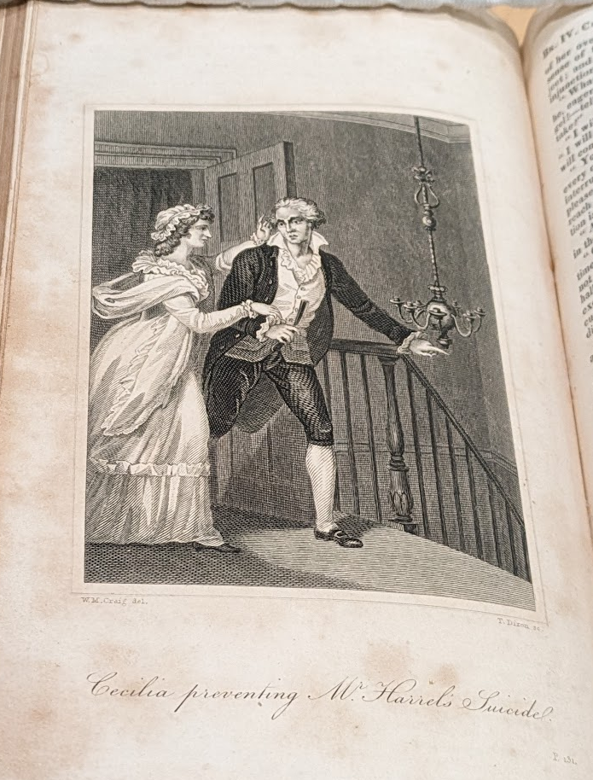
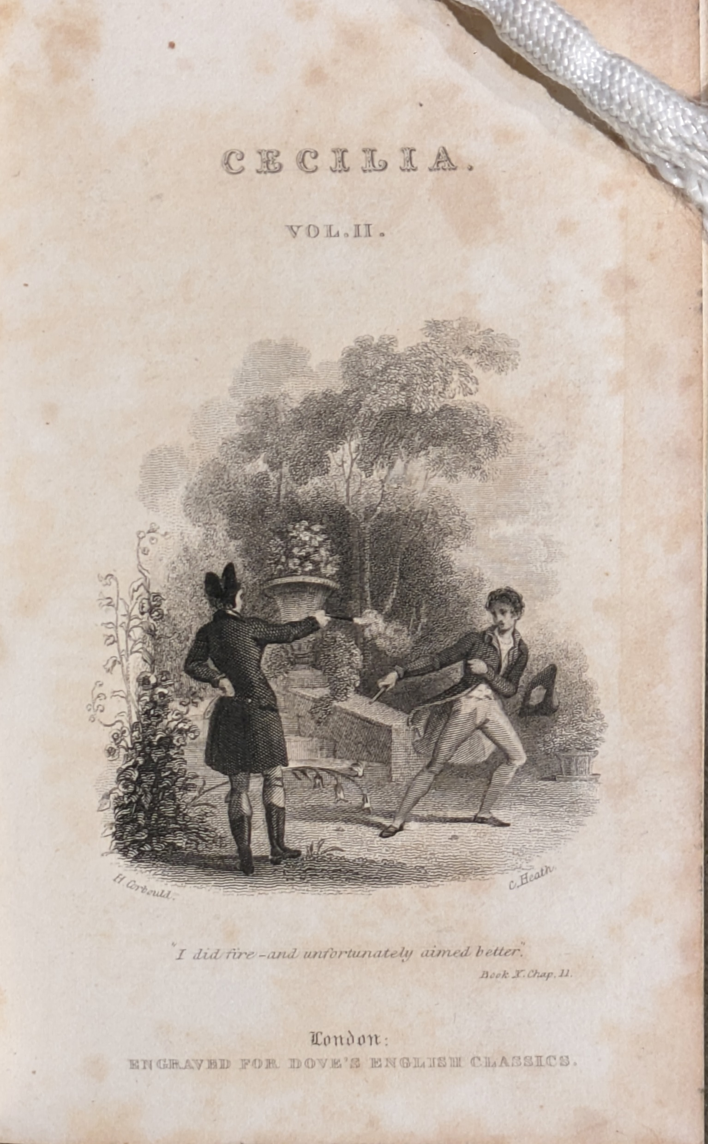
“Cecilia preventing Mr. Harrel’s Suicide”
Cecilia: or, Memoirs of an Heiress. By Madame D’Arblay. 1 vol. “Embellished with Elegant Engravings.” London: Printed at the Caxton Press, by Henry Fisher, “(Printer in Ordinary to His Majesty.)”, [Aug. 1822].
“I did fire – and unfortunately aimed better. Book X. Chap. II.” [Delvile firing on Monckton in a duel]
Cecilia: or, Memoirs of an Heiress. By Miss Burney. 2 vols. London: Printed and Published by J.F. Dove, St. John’s Square, “Engraved for Dove’s English Classics.” [1820].

Slide 4
Avoidance
Harrel:
And by this method, which he constantly practised, of avoiding any private conversation, he frustrated all her schemes of remonstrating upon his delay, since her resentment, however great, could never urge her to the indelicacy of dunning him in presence of a third person. (vol. 2, bk. 3, ch. 4)
Her next effort was to remonstrate with Mr. Harrel himself; but this scheme was not more easy of execution than the other, since Mr. Harrel, suspecting she meant again to dun him for her money, avoided all separate conversation with her so skilfully, that she could not find a moment to make him hear her. (vol. 2, bk. 3, ch. 8)
Monckton:
In the evening she had again a visit from Mr. Monckton, who, though he was now acquainted how much she was at home, had the forbearance to avoid making frequent use of that knowledge, that his attendance might escape observation. (vol. 1, bk. 2, ch. 3)
Mr. Monckton, though his principal study was carefully to avoid all public gallantry or assiduity towards Cecilia, had not the forbearance to resist this intimation, and therefore she had the pleasure of telling Sir Robert, when he asked the honour of her hand for the two first dances, that she was already engaged. (vol. 3, bk. 5, ch. 1)

Slide 5
Avoidance (cont.)
Delvile:
he had evidently avoided her while it was in his power, and when, at last, he was obliged to meet her, he was formal, distant, and reserved. (vol. 3, bk. 5, ch. 1)
Delvile, far from manifesting any design of conquest, shunned all occasions of gallantry, and sedulously avoided even common conversation with her. (vol. 3, bk. 6, ch. 3)
http://tinyurl.com/Havens-SEASECS

Slide 6
Manipulation
Harrel:
Her terror was now inexpressible; she believed him in the very act of suicide, and her refusal of assistance seemed the signal for the deed…
At these words he opened it; his face was totally without colour, and he grasped a razor in his hand.
“You have stopt me,” said he, in a voice scarce audible, “at the very moment I had gathered courage for the blow: but if indeed you will assist me, I will shut this up,—if not, I will steep it in my blood!” (vol. 2, bk. 4, ch. 5)
Monckton:
“…is not any thing preferable to dwelling with Mr. Briggs?”
“Certainly,” said Mr. Monckton coolly, “nor should I have supposed he had any chance with you, had I not hitherto observed that your convenience has always been sacrificed to your sense of propriety.”
Cecilia, touched by praise so full of censure, and earnest to vindicate her delicacy, after an internal struggle, which Mr. Monckton was too subtle to interrupt, protested she would go instantly to Mr. Briggs, and see if it were possible to be settled in his house, before she made any attempt to fix herself elsewhere. (vol. 3, bk. 5, ch. 7)
“Good God,” cried he, “Miss Beverley, what is this you have done? bound yourself to marry a man who despises, who scorns, who refuses to own you!” (vol. 4, bk. 7, ch. 7)

Slide 7
Manipulation (cont.)
Delvile:
…weigh your objections against the consequences which must follow. It is discovered I attended you in town; it will be presumed I had your permission for such attendance: to separate, therefore, now, will be to no purpose with respect to that delicacy which makes you wish it….it will cast over your own conduct a veil of mystery and obscurity wholly subversive of that unclouded openness, that fair, transparent ingenuousness, by which it has hitherto been distinguished. (vol. 4, bk. 8, ch. 1)
…her consent to a clandestine action she lamented as an eternal blot to her character, and the undoubted publication of that consent as equally injurious to her fame. Neither retracting nor fulfilling her engagement could now retrieve what was past, and in the bitterness of regret for the error she had committed, she thought happiness unattainable for the remainder of her life. (vol. 4, bk. 8, ch. 1)
“Do you bring me any message from Mr. Monckton?”
“From Mr. Monckton?—no; but he lives and will recover.”
“I thought you had been Mr. Monckton yourself.”
“Too cruel, yet justly cruel Cecilia!—is then Delvile utterly renounced?—the guilty, the unhappy Delvile!—is he cast off for ever? have you driven him wholly from your heart? do you deny him even a place in your remembrance?” (vol. 5, bk. 10, ch. 8)
http://tinyurl.com/Havens-SEASECS

Slide 8
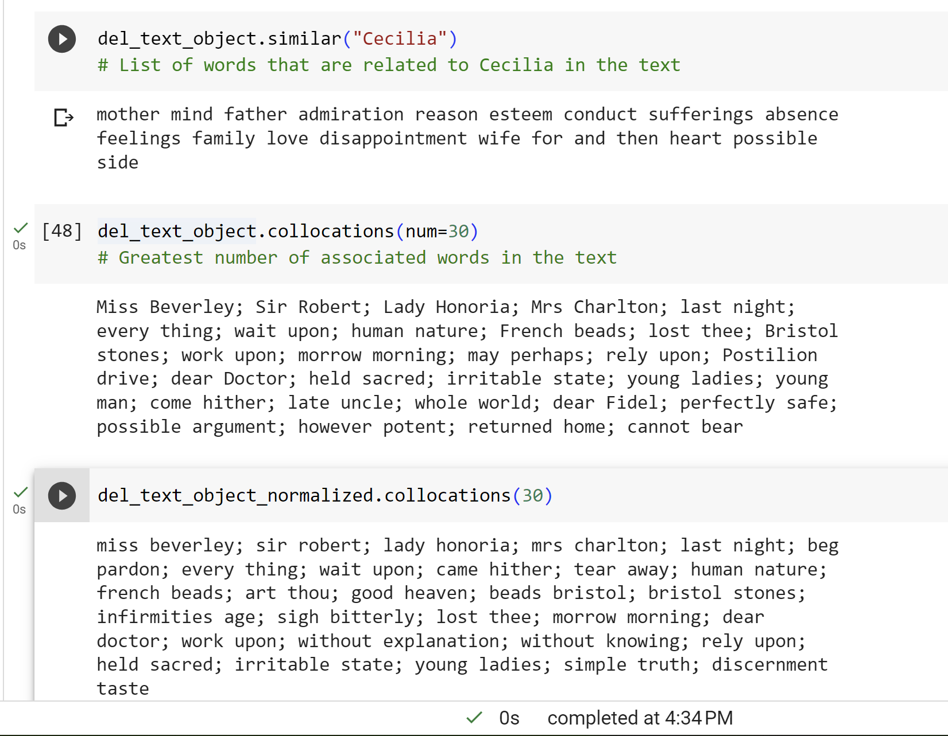
Sample Output from Natural Language Toolkit (NLTK)
http://tinyurl.com/Havens-SEASECS

Slide 9
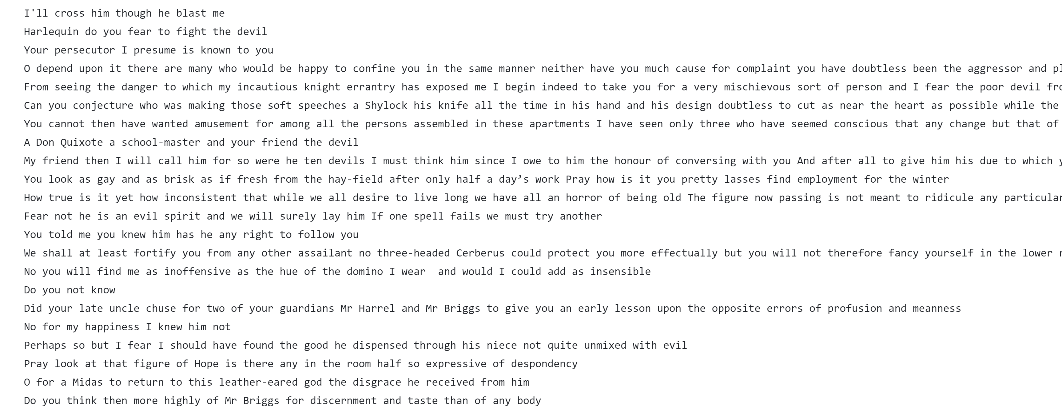
Sample Processed Text (delvile_sw.txt)
http://tinyurl.com/Havens-SEASECS

Slide 10
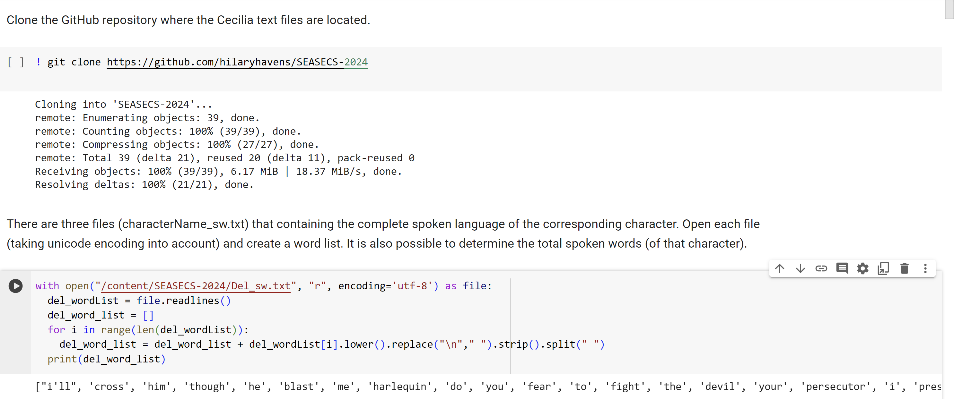
Sample Jupyter Notebooks Code (Cecilia_Language_SEASECS_2024.ipynb)
http://tinyurl.com/Havens-SEASECS

Slide 11
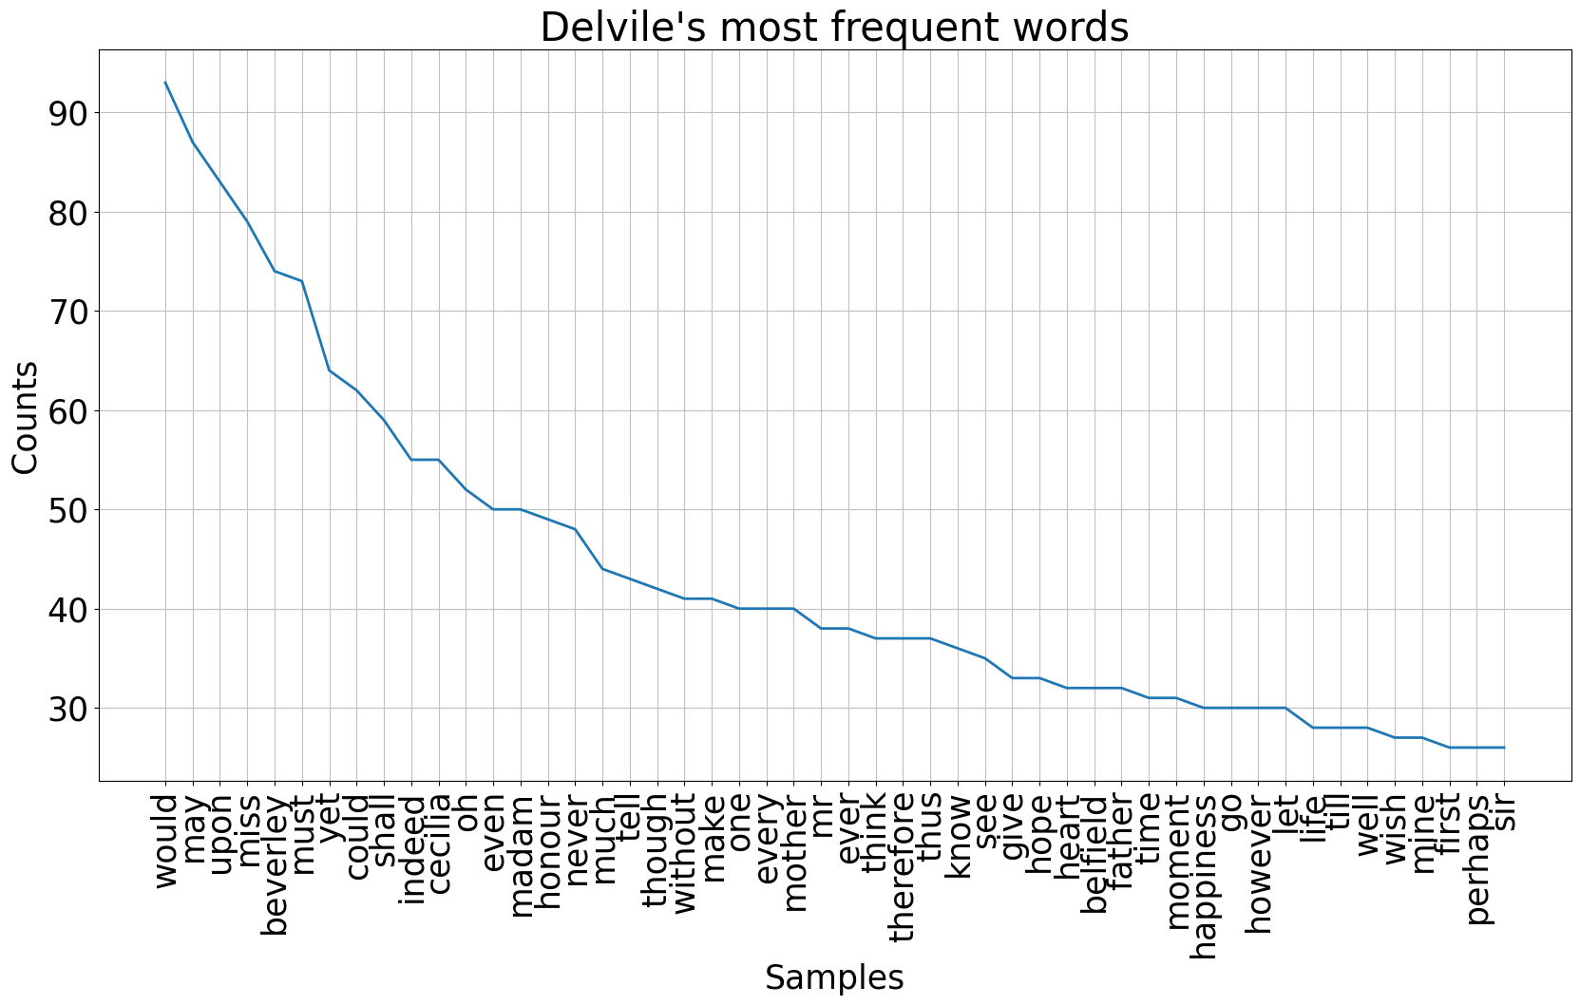

Slide 12
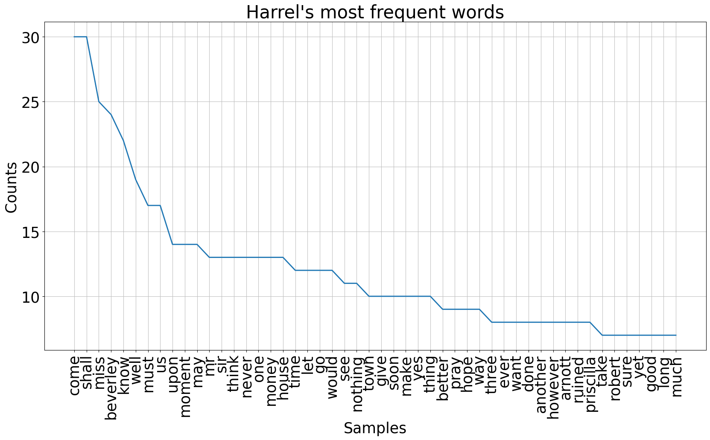

Slide 13
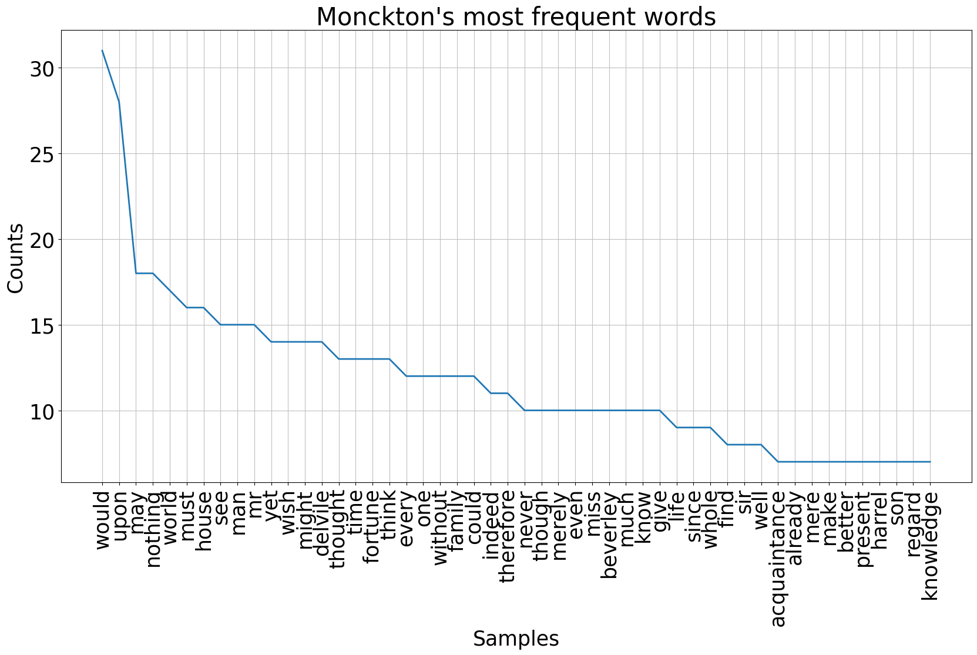

Slide 14
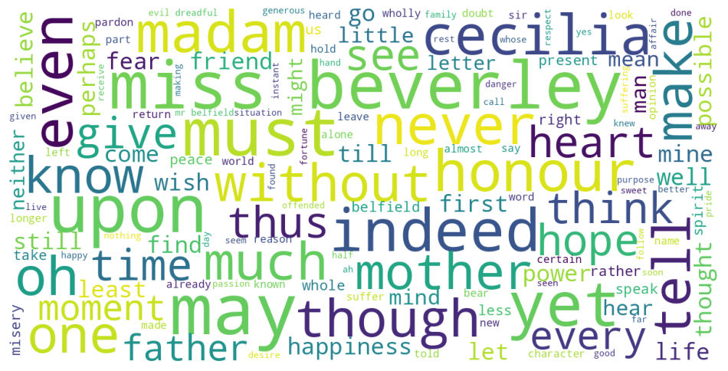
Delvile Word Cloud

Slide 15
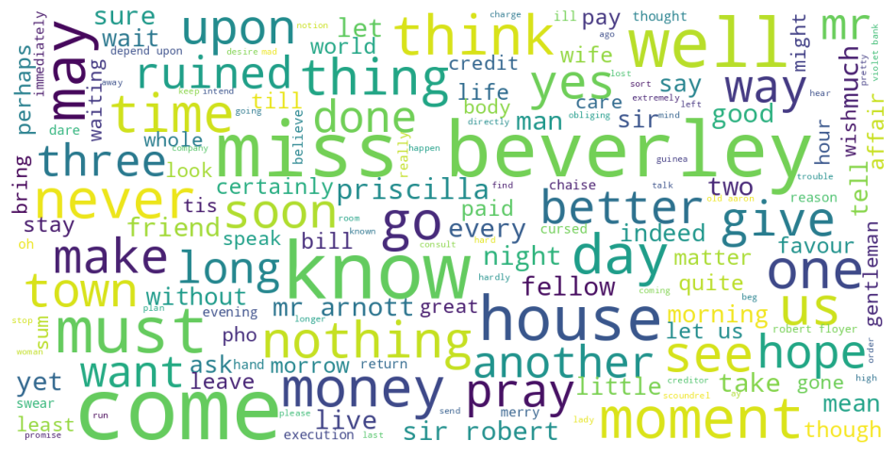
Harrel Word Cloud

Slide 16
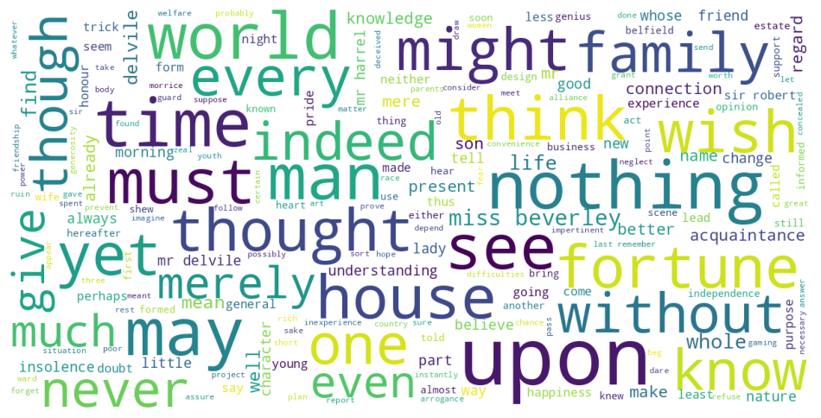
Monckton Word Cloud

Slide 17
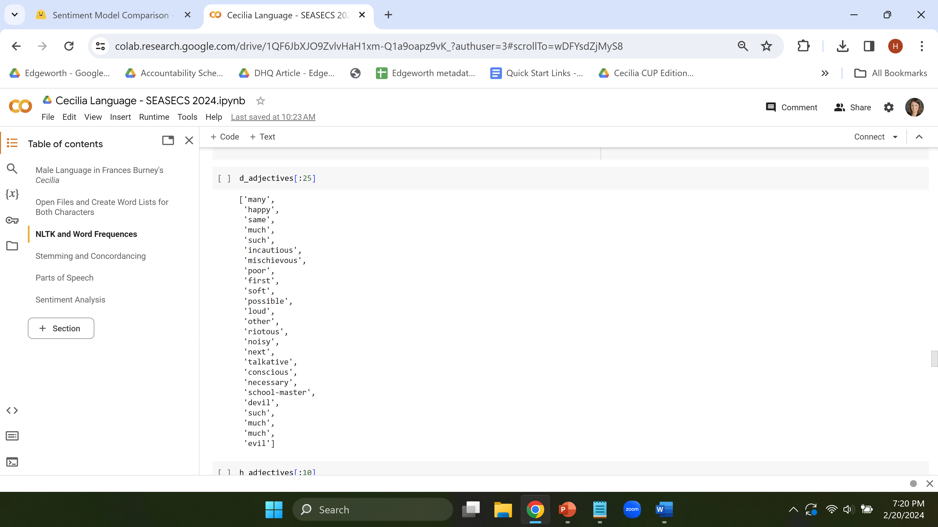
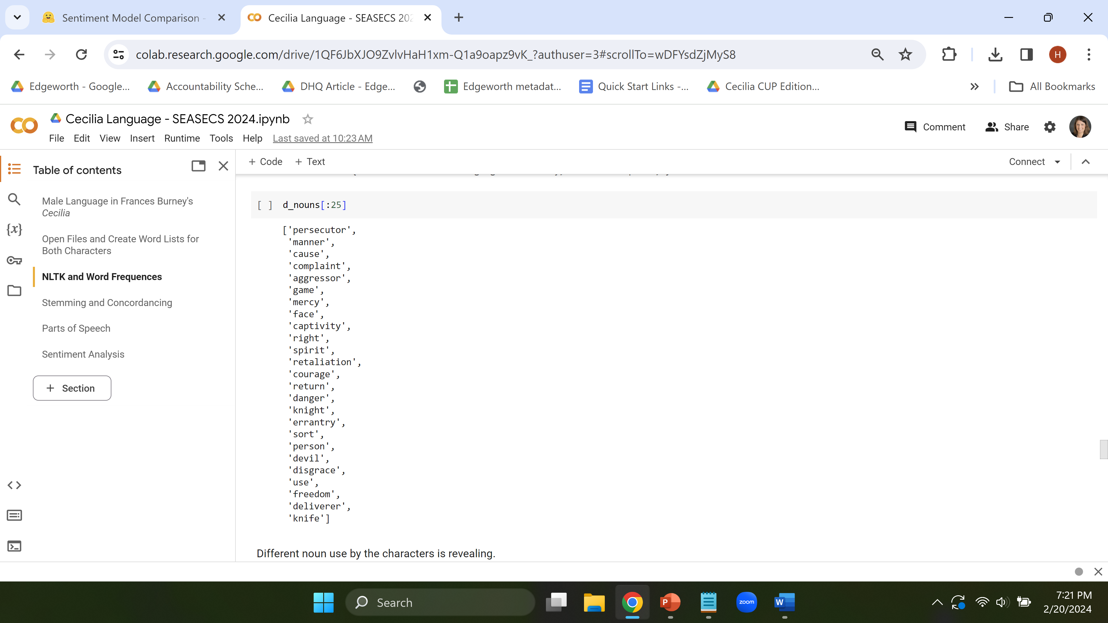
NLTK Parts of Speech Tagging

Slide 18
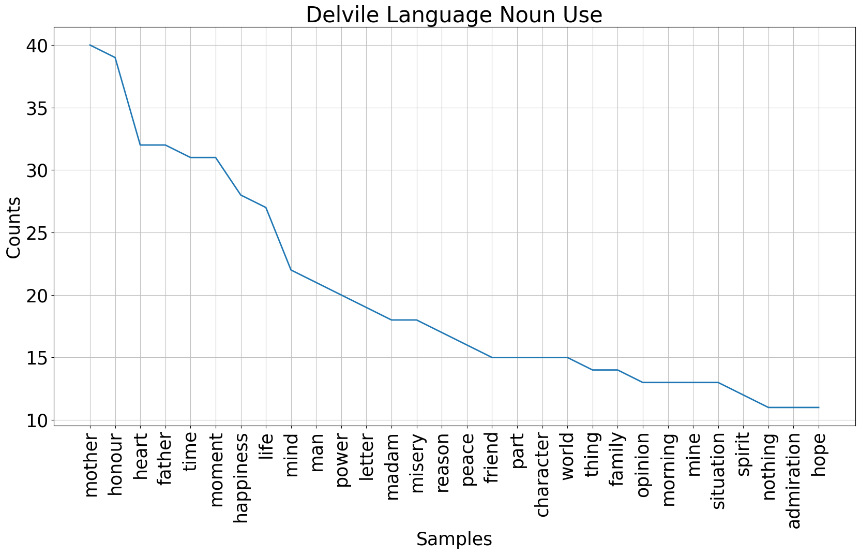

Slide 19
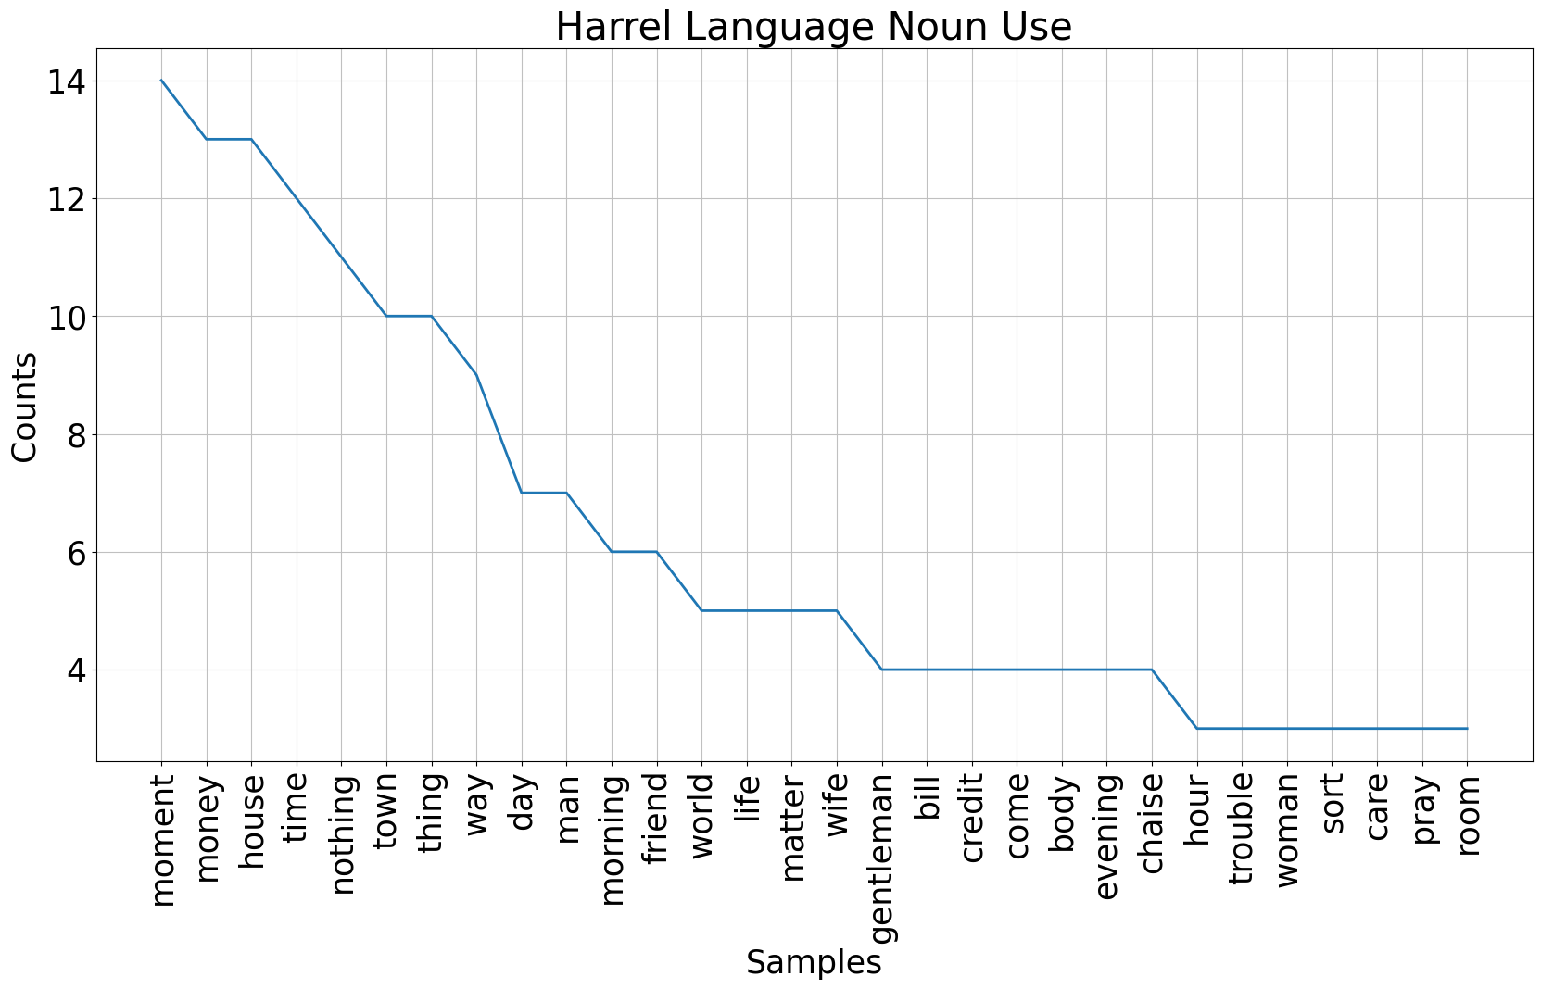

Slide 20
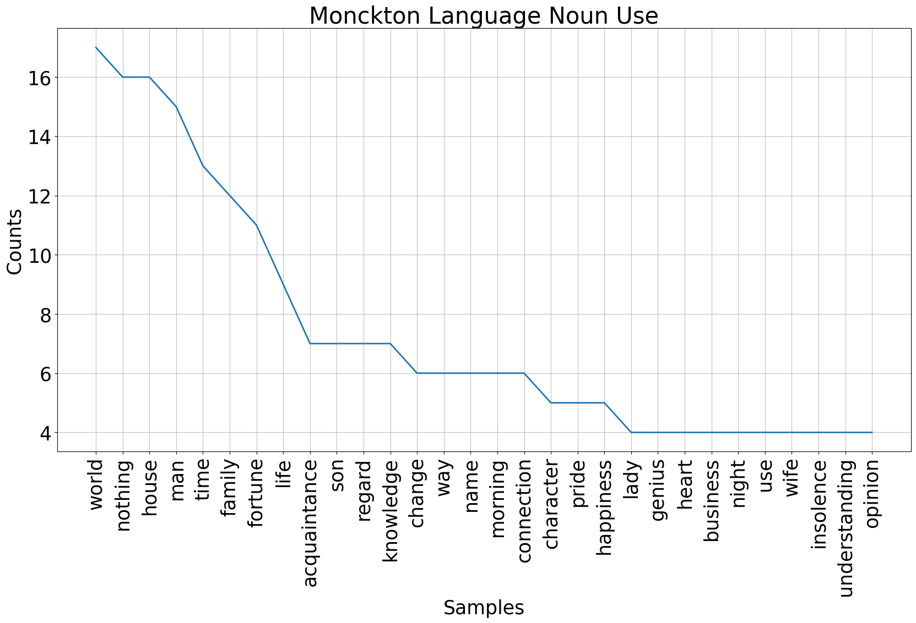

Slide 21
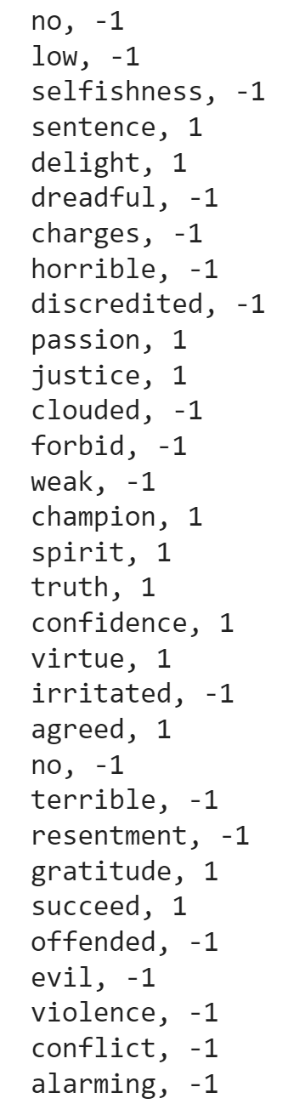
Sample VADER (Valence Aware Dictionary and sEntiment Reasoner) Output
http://tinyurl.com/Havens-SEASECS

Slide 22
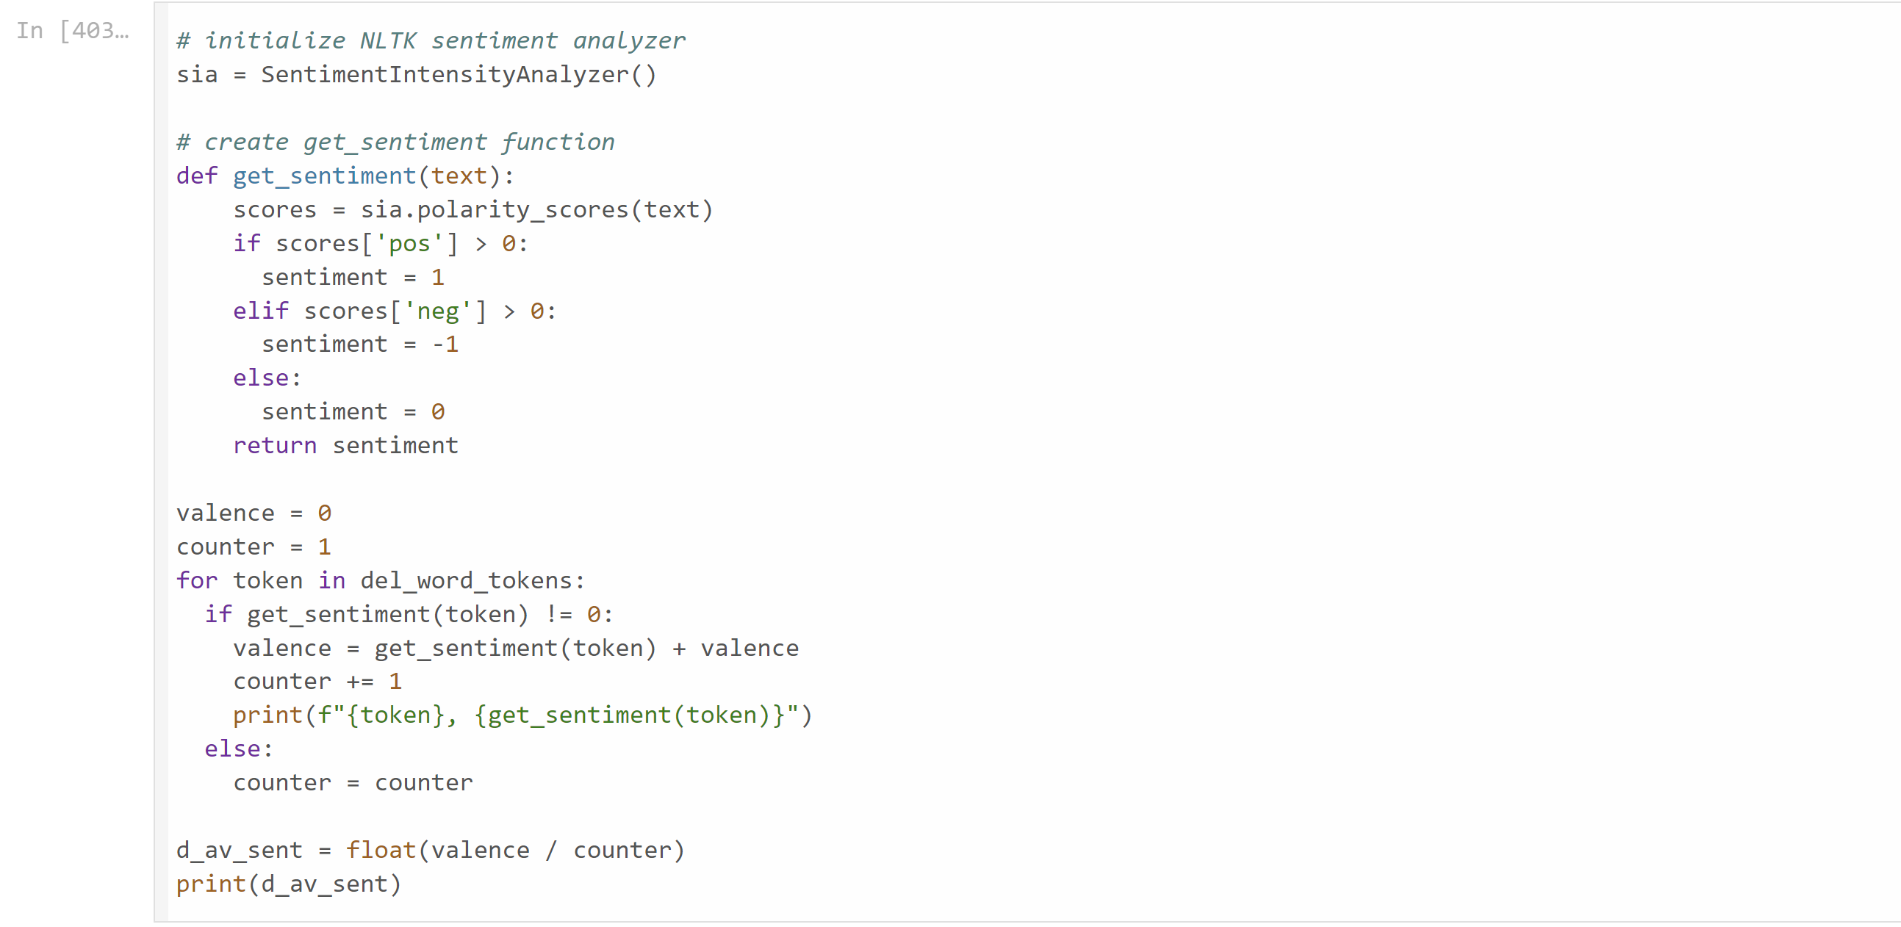
Positivity Scores Code for Cecilia

Slide 26
For additional data:
http://tinyurl.com/Havens-SEASECS

